Slide 1
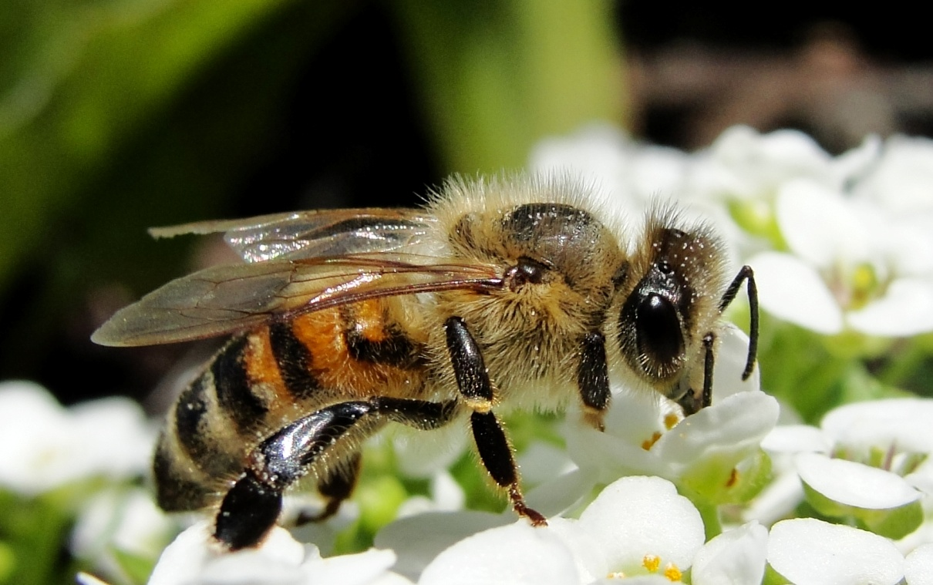
Why are Bees Important?
Bees are in a rapid decline and if not stopped could cause a major collapse of society.

Slide 2
Why are BeEs Important?
In 1945 there were an estimated 4.5 million bees. Studies were done in 2007 that showed the number declined to 2 million bees. That’s a loss of over 2 million bees since WWII.
Why are these bees disappearing? It seems that human interaction with the environment has caused a negative impact with the way we plant and tend to our crops.
The removal of cover crops, weeds and use of chemicals to prevent weeds and pests to up our yield of crops, created a devastating impact on bees.

Slide 3
Why Are Bees Important?
Before WWII Fields of cover crops and Fields of flowers were more abundant.
After though, more fields are being filled with crops and not as many flowers.

Slide 4
Why are Bees Important?
Most Gardeners don’t mean to harm bees. However, studies on board spectrum pesticides have shown to be toxic to not only the pests but to good insects such as bees. Causing an array of symptoms from disorientation to death in important and keystone bee species.

Slide 5
Why Bees are Important
Here are some of the crops that would disappear without bees:
1. Apples Surprise, surprise — the nation's largest producer of apples is Washington State. In a typical year, 10 to 12 billion apples are harvested every year by hand, or put another way, about three out of five apples in the United States come from Washington. That's staggering — and without bees, the cross-pollination needed to produce apples just wouldn't happen on a scale large enough to produce today's crop.
2. Almonds About 80 percent of the world's almond supply comes from California, which requires about half of the honeybee population in the United States for pollination each year. Valued at more than $3 billion, this crop is California's top agricultural export. This year's crop is the largest ever, at 1.9 billion pounds, most of which is destined for locales in Asia, Europe, and the Middle East. The almond crop is completely dependent on honeybees for pollination.
3. Blueberries Besides being loaded with antioxidants, they're also delicious on top of pancakes, in muffins, and of course, in pie. The loss of the blueberry crop wouldn't just be felt at the kitchen table, however — the National Agricultural Statistics Service values the nation's blueberry crop, most of which comes from Maine, at more than $593 million, 90 percent of which is pollinated by honeybees.
4. Cherries Honeybees are responsible for pollinating about 90 percent of the cherries in the United States, according to the National Agricultural Statistics Service, most of which come from Washington State. Sweet cherry trees require the pollinating activities of honeybees in order to produce enough fruit for a commercially viable crop.
5. Avocados The National Agricultural Statistics Service reports that 90 percent of the avocados grown in the United States rely on honeybees for pollination. How does that saying go? No avos means no guac. No guac means no party. Boo.
6. Cucumbers Cucumbers are a popular option for cooling down in the hot summer months. Their cool, fresh flavor and crunchy bite make them a popular addition to salads, sandwiches, and cocktails. Without honeybees, though, the majority of the country's $193 million cucumber crop would be nonexistent.
7. Onions No onions? Well, you're pretty much screwed. Onions are the base for myriad classic sauces, soups, and stews when cooked, and when raw, are pretty much de facto in tacos, salsas, sandwiches, burgers, and salads. You'll still be shedding tears even when they're gone.
8. Grapefruit Sweet-tart grapefruit, whether eaten with a spoon or cut into segments by the ambitious, is a breakfast staple for the health conscious. It's also delicious in salads and blended into smoothies and cocktails. Grapefruit is just one of many kinds of citrus almost entirely dependent on honeybees for pollination.
9. Orange It probably goes without saying that if you're going to bring up grapefruit, you have to bring up oranges. And the data actually do back this up; like grapefruit, oranges are 90 percent dependent on honeybees for production. That morning cup of orange juice would get a lot more expensive. Maybe we'll just import our way out of this one — except, colony collapse disorder is a worldwide problem.
10. Pumpkins Halloween just wouldn't be the same without pumpkins, nor would Thanksgiving. This iconic American crop is heavily dependent on honeybees for production, and without them, there would be no pumpkin carving and no pumpkin pie.

Slide 6
Why Bees are Important
What can you do to help?
Let weeds such as clover and dandelions grow in your yard.
Plant Bee friendly gardens: flowers, vegetables and plants that reseed through out the growing seasons (spring to fall).
Invest in organic and locally grown crops.
Buy from local bee keepers
Keep a bird bath with small pebbles so bees can get water
Place a bee box – native bees that would live in a bee box don’t typically swarm or sting.
Don’t use pesticides, fungicides or other chemicals on your lawn.

